Slide 1
Secrets for Leading in the New Normal
David Singleton, Charlotte Mecklenburg Library
Julie Walker, Georgia Public Library Service
Metrolina Library Association Conference
June 2014

Slide 2
Changes in society

Slide 3
People love libraries

Slide 4
Perceptions of Libraries 2013
 | National (Pew Study) 2013 | Mecklenburg County 2013
Public libraries important to the community | 91% | 97%
Public libraries important to them and their families | 76% | 86%
Free access to computers & Internet important | 77% | 91%

Slide 5
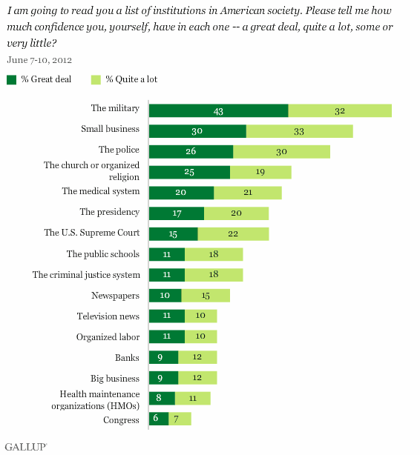
How Libraries Stack Up
How confident?
How important?

Slide 6
But are they coming through the doors?

Slide 7
Reductions for Non-Mandated Services
Reductions in hours, staffing, and collections
Reduced public access
Reduction in public perception of library value/ relevance

Slide 8
Cost of Library Services
*Per day costs of Library Services Based on Mecklenburg County Taxable Parcels

Slide 9
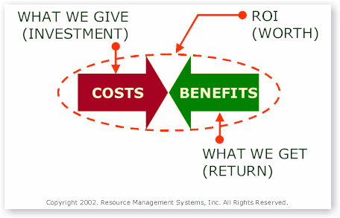
ROI Study: Broad Benefits
ROI Study conducted by UNC Charlotte Urban Institute
Charlotte Mecklenburg Library returns $4.57 in direct benefits for every $1.00 invested from all sources.
Notes:
As most of you know, Return on Investment (ROI) refers to the income, or value, received as a result of an amount invested in an asset. In terms of public libraries, ROI refers to the return on the public’s investment (i.e. tax dollars) in its libraries.
For every $1.00 invested in the Charlotte Mecklenburg Library from all sources, the community receives between $3.15 and $4.57 in direct benefits. In addition, the community receives $1.46 of indirect economic impact through such expenditures as payment of salaries, and building and equipment costs.
Based on the results from the survey, the Urban Institute estimates that the Charlotte Mecklenburg Library provides a value between $72.5 million and $128.1 million in quantifiable direct benefits annually.
Overall, the Return on Investment to the public for the tax dollars expended on library services is significant, providing yet another important consideration in the ongoing public dialogue about the future of the Charlotte Mecklenburg Library system.

Slide 10
Libraries Change Lives! (Don’t they?)

Slide 12
How do you know when your organization is successful?

Slide 13
Traditional Measures (what we do)
Checkouts/circulation
Program attendance
Reference transactions
Registered users

Slide 14
Outcomes (the difference we make)
Young children prepared to succeed in kindergarten
Children and teens succeeding in school
A more literate community
Residents proficient with computer skills
Adults getting jobs

Slide 16
So why change what we measure?
Articulate relevance in the 21st century
Articulate value/impact to community
Articulate value/impact to funders
Competitive funding advantage

Slide 17
If you always do what you always did, you will always get what you always got.
--Albert Einstein

Slide 18
Intended results
Planned work/ activities

Slide 19
Outcome = Change in behavior, attitude, skill, knowledge, or status as a result of intentional actions

Slide 20
Outcome Measures
Answers the question “So what?”
Help define value
– What is the value of what we are measuring?
– Is there a benefit to what we are putting into it?
– What value do we bring to the community?
Help demonstrate that resources are producing results

Slide 21
Outcome Measure Example
97% of parents/caregivers attending pre-school programs reported that they are better prepared to develop pre-reading skills in their children

Slide 22
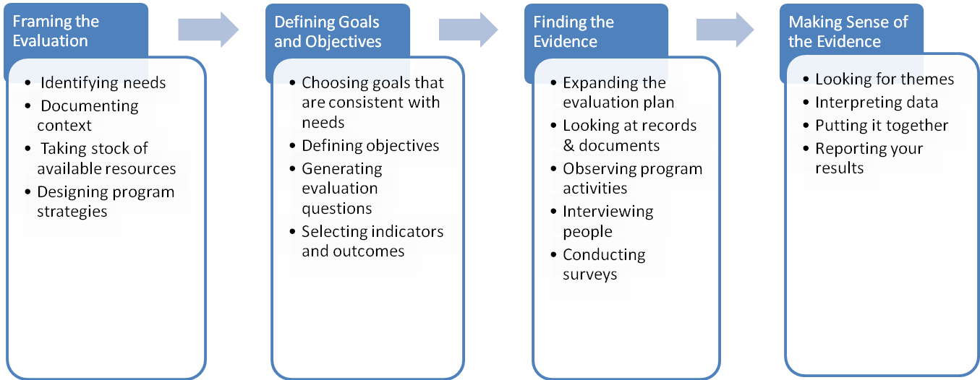
Overview of the Outcome Based Evaluation Process
Notes:
See? Just 4 steps…not rocket science!

Slide 23
21st Century Library
Flexible spaces
Innovations in self service/convenience
Anticipating needs of customers
Foreign language services
Social media as a customer touch point
Libraries as ‘place’
Libraries as innovation labs

Slide 24
Organizational Excellence/ Sustainability
Human capital (staff and volunteers)
Leadership
Focus
Process improvement
Flexibility of staff/cross-training
Change management

Slide 25
Where does your library fit in today’s world?
Do people come to us, or do we go to people?
Access any time, anywhere, any device
New media is the new neighborhood
We share the stage with amateur experts
Are we a trusted node in the social network?
Lee Rainie, Pew Internet & American Life Project

Slide 26
What must a 21st century leader do?
Align people around the organization’s mission and values
Empower leaders at all levels
Serve. Provide customers with superior value
Collaborate, internally and externally

Slide 27
Five Practices of Progressive Leaders
Model the way
Inspire a shared vision
Challenge the process
Enable others to act
Encourage the heart
--Kouzes and Posner

Slide 28
The Stages of Change
Stage
One
Stage
Two
Stage
Three
Stage
Four
Active
Anger
Testing
Balancing
Confusion
Passive
DEFENSIVE
RETREAT
ACKNOW-LEDGEMENT
SHOCK
ACCEPTANCE
Stability
Time
Stages - CAPS
Phases - Italics

Slide 29
Self Awareness—Johari Window

Slide 30
How can libraries thrive?
Connect with community needs
Contribute uniqueness
Act effectively, pursuing clearly-understood priorities and goals
Empower staff at every level
Collaborate with others
Be resilient…today, more than ever
Embrace change
Stay grounded
Tell your story!

Slide 31
The best way to predict the future is to invent it.
--Alan Kay

Slide 32
Questions?
dsingleton@cmlibrary.org
jwalker@georgialibraries.org

